Slide 2
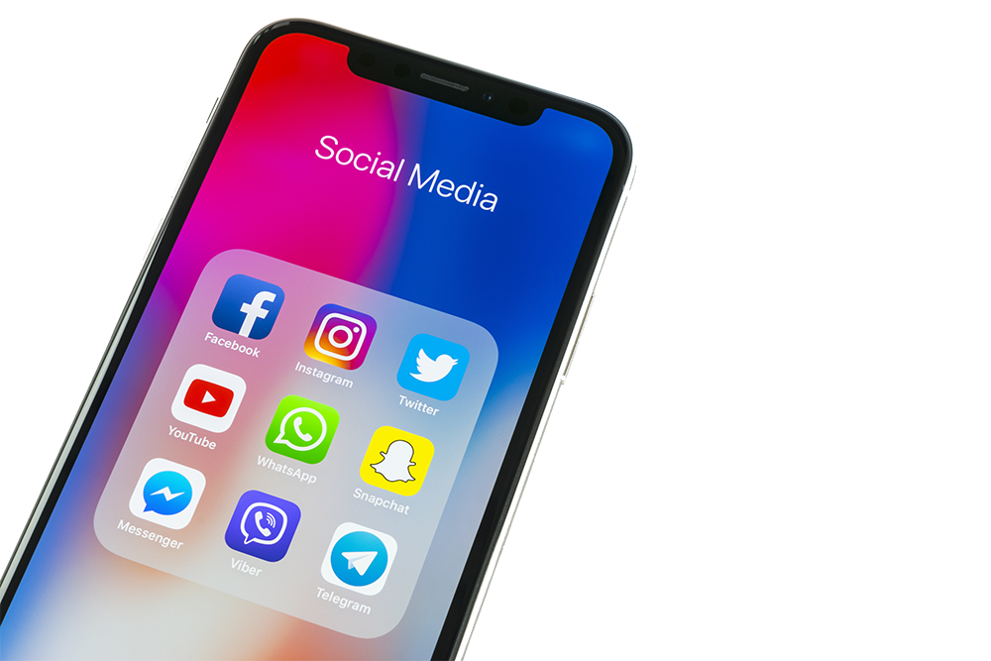
Social Media and a Full Digital Media Campaign is Essential to Success
Objective of Digital Media combined with Hispanic Online Directory Platform:
To insure maximum traffic to any given website and or client’s Hispanic campaign. With www.listaslocales.com it is imperative to maximize the amount of positive traffic, Impressions through to conversions.
We accomplish this through a series of relevant, current, industry applicable posts.
In other words, our Blogs, newsletters, Posts our second to none. Our reach is vast. With access to over 250,000 registered users, hundreds of Hispanic FB groups with thousands of Members, Shares and likes in addition to Twitter campaigns and many others.
We don’t just post. We entertain, inform and educate.
We believe “The best way to sell something - don't sell anything. Earn the awareness, respect, and trust of those who might buy."
Join us while we bring clients the results, they expect.
It is not just placing listings and display ads on the site. It’s about linking your clients' brand with the wants and needs of Hispanic consumers through the trust and integrity we have built over decades!

Slide 3
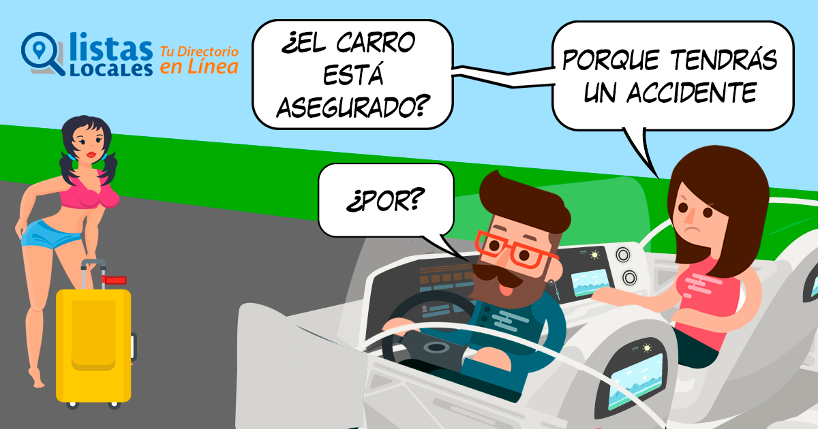
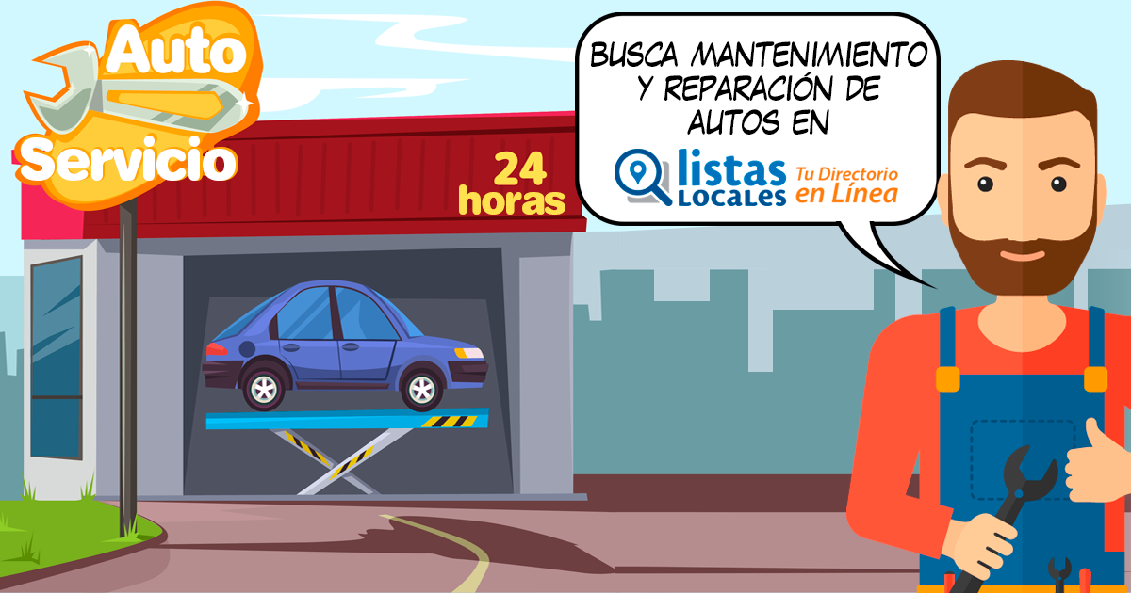
Post Social Engagement Examples to follow
We use our social networks to drive traffic to client categories (Where your advertising appears).
We boost with our budget, posts in Facebook, blogs, newsletters etc... to generate more traffic in categories related to client vertical. We analyze the best cities and associated traffic to secure qualified leads.
Auto Insurance
Home Insurance
Life Insurance
Related category to Auto Insurance
Roadside Assistance

Slide 4
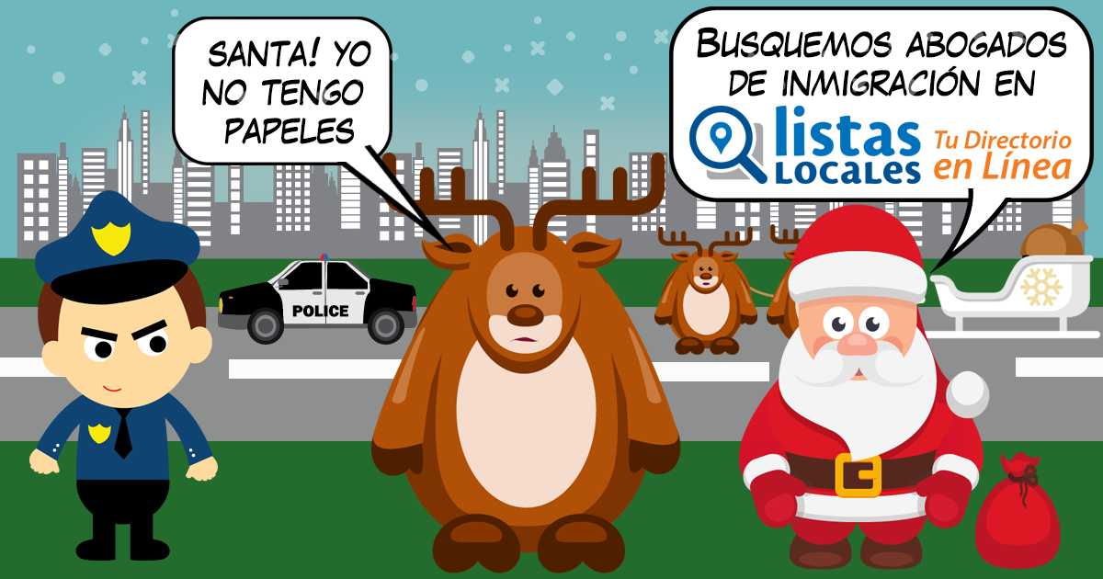
Static Post Social Engagement
Car Accident Attorneys
Car Accident Attorneys
Drug And Alcohol Services
Auto Repair Shops
Plumbers
Immigration Attorneys

Slide 5
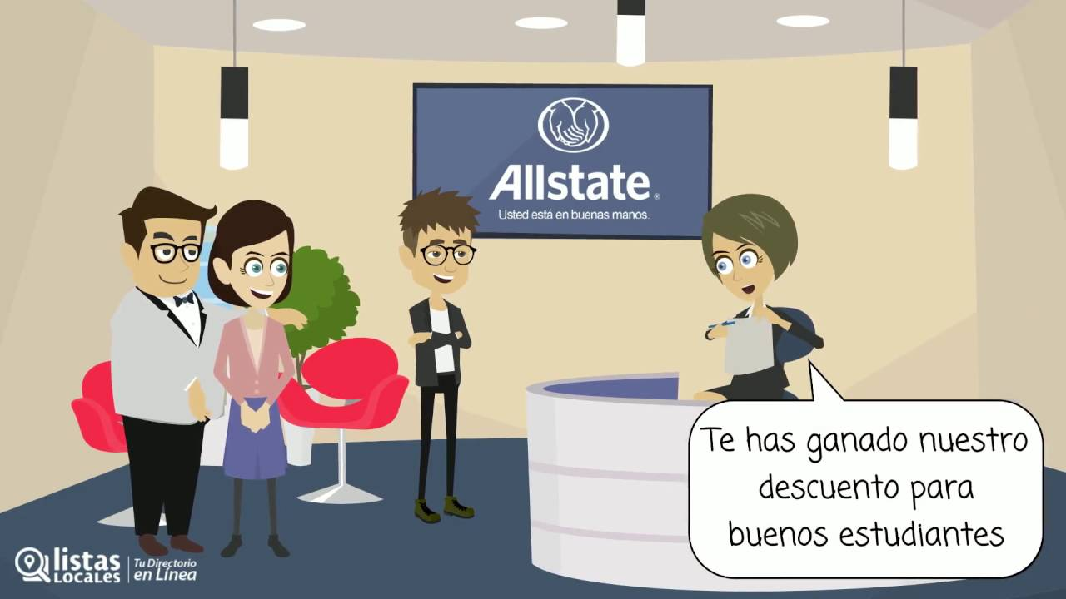
Video Examples Social Engagement
Reaching, attracting usage, Blogs, Instructional videos industry complimentary, backlinks, full social campaigns with client vertical specific campaigns. Take Insurance vertical for example.
Auto, Home, Life, Business, Renters, Motorcycle Insurances.
YouTube Video Examples
https://youtu.be/aWW1_W_-Mhw
https://youtu.be/K7D3E1sff20
https://youtu.be/GLbqVnUmPmI
Video Is The Most Engaging Facebook Format
Videos are the Facebook format most likely to reach and engage audiences.
We generate traffic to our website to related insurance categories.

Slide 6
Video Social Engagement
Auto Insurance, Home, Life
Restaurants, Banks, Doctors, Dentist…
Attorneys, Immigration Attorneys…
Home Security System
Gyms And Fitness Centers
Pharmacies

Slide 7
Blog / Newsletters
We have registered more than 250,000 users in Listas Locales and every day it grows.
We have active bloggers/Influencers with hundreds of thousands of followers, with news every day related to the Latino consumers which is engaging, educational and entertaining.
We have several types of campaigns to drive qualified prospects and increase traffic to related categories.
The News is reached organically within Listas Locales and published on social networks.
Increase backlinks to potential categories.
Drive more traffic and quality calls to specific clients or categories.
Our biggest traffic is organic, due to our SEO, which comes from Google, Bing and Yahoo.
These different actions help us to achieve greater reach to users and improve ROI percentages. We focus our effort towards the category of the client with a vested interest in results.
Visit www.listaslocales.com

Slide 8
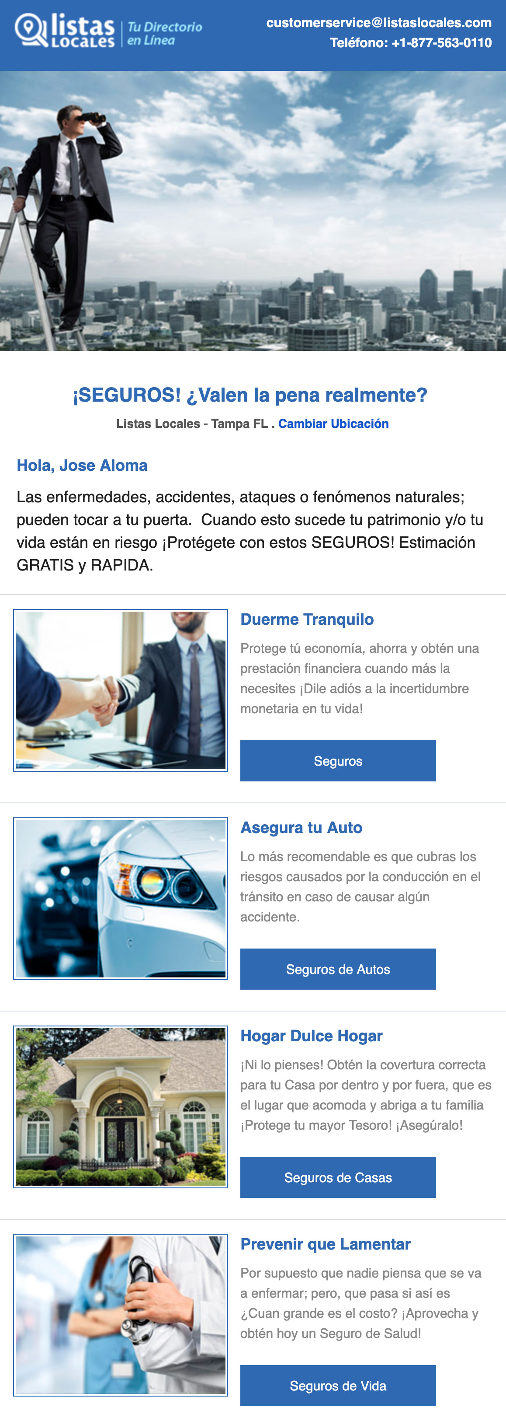
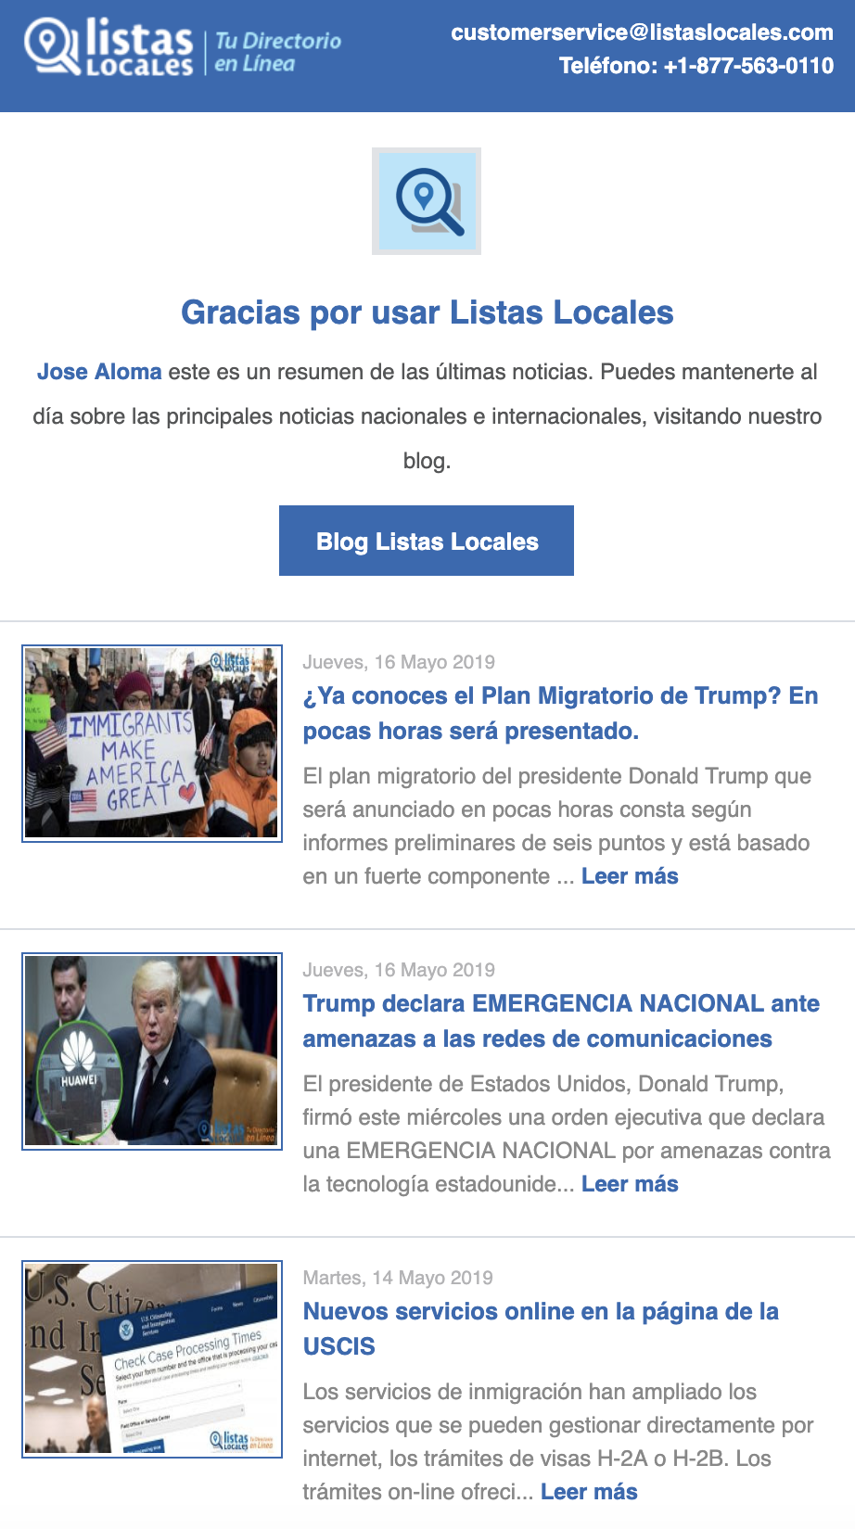
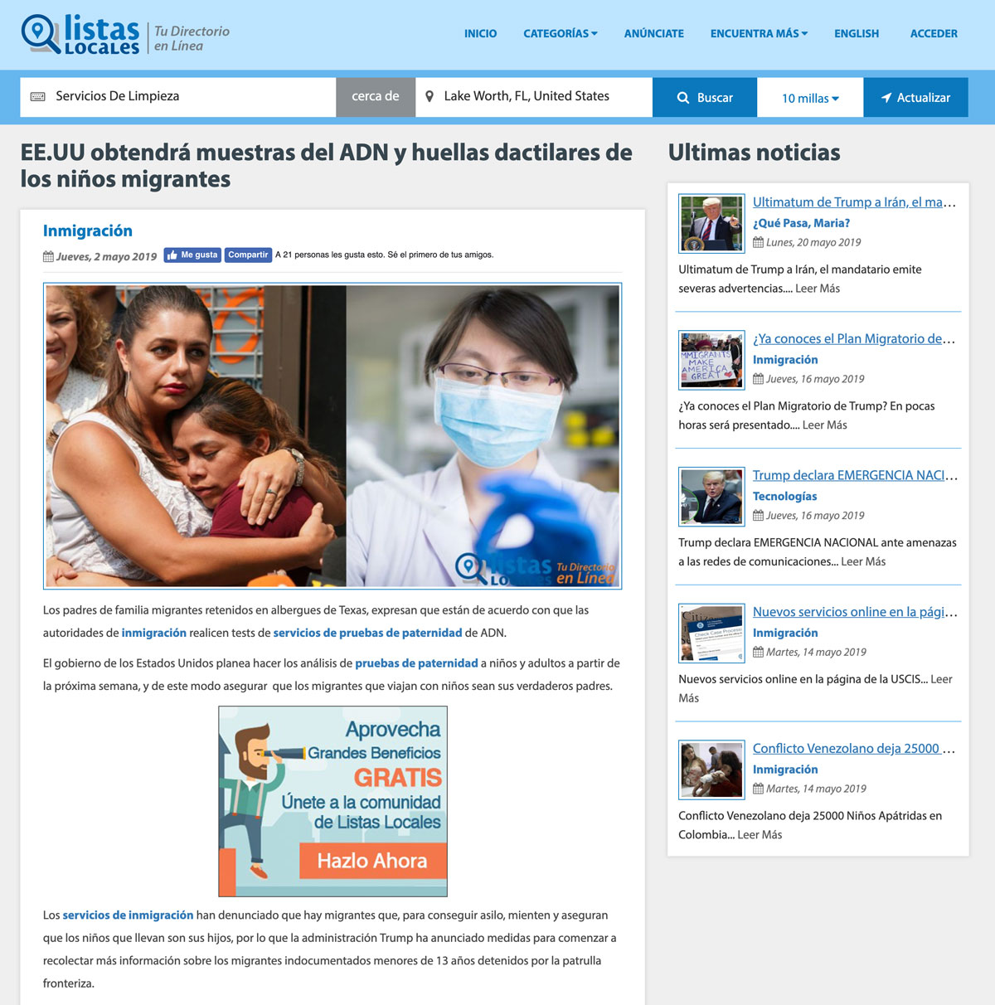
Blog / Newsletter Examples
Backlink Insurance
Backlink
Auto Insurance
Backlink
Home Insurance
Newsletters
Blog in Listas Locales
Email Campaign
Visit www.listaslocales.com
Backlink
Health Insurance

Slide 9
Bulletin
This bulletin is general for insurance clients however varies by day by industry.
When the user registers, we acquire the zip code and the city where they are located.
We show brief information about insurance and direct links to categories such as:
Insurance, Auto Insurance, Home Insurance, Life Insurance.
Once a user clicks in that category, they will be redirected to the results listings where Insurance agents and advertising is located.
City, State
Backlink to insurance category where the user is located.
Backlink to auto insurance.
*These bulletins can be modified to any category, any promotion,
message. Adapted to the customer, with the company logo, image
or the RCF phone number inside the body text or simply provide positive
PR messaging for a specific client or industry/category.
Backlink to home insurance.
Backlink to health insurance.

Slide 10
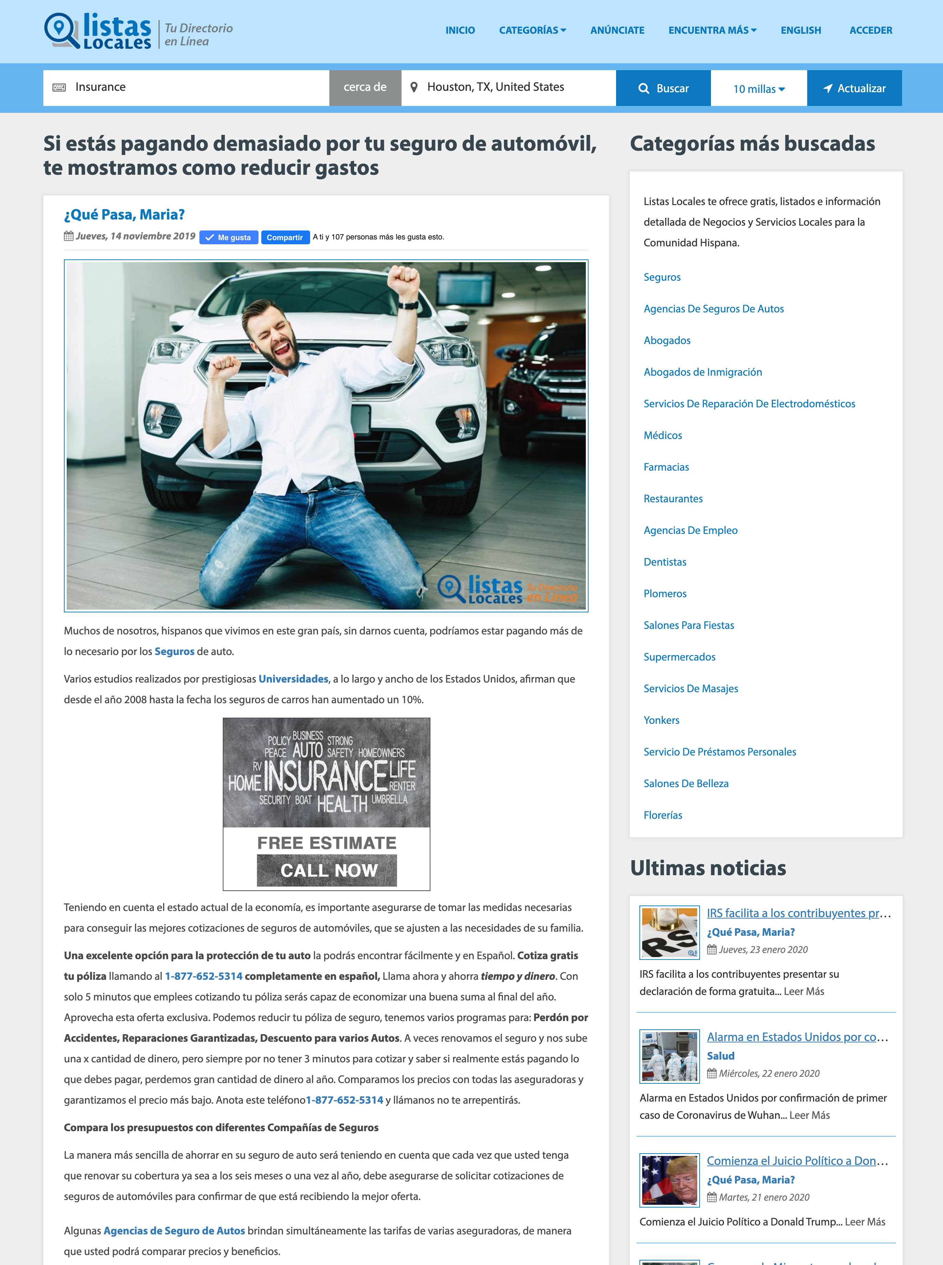
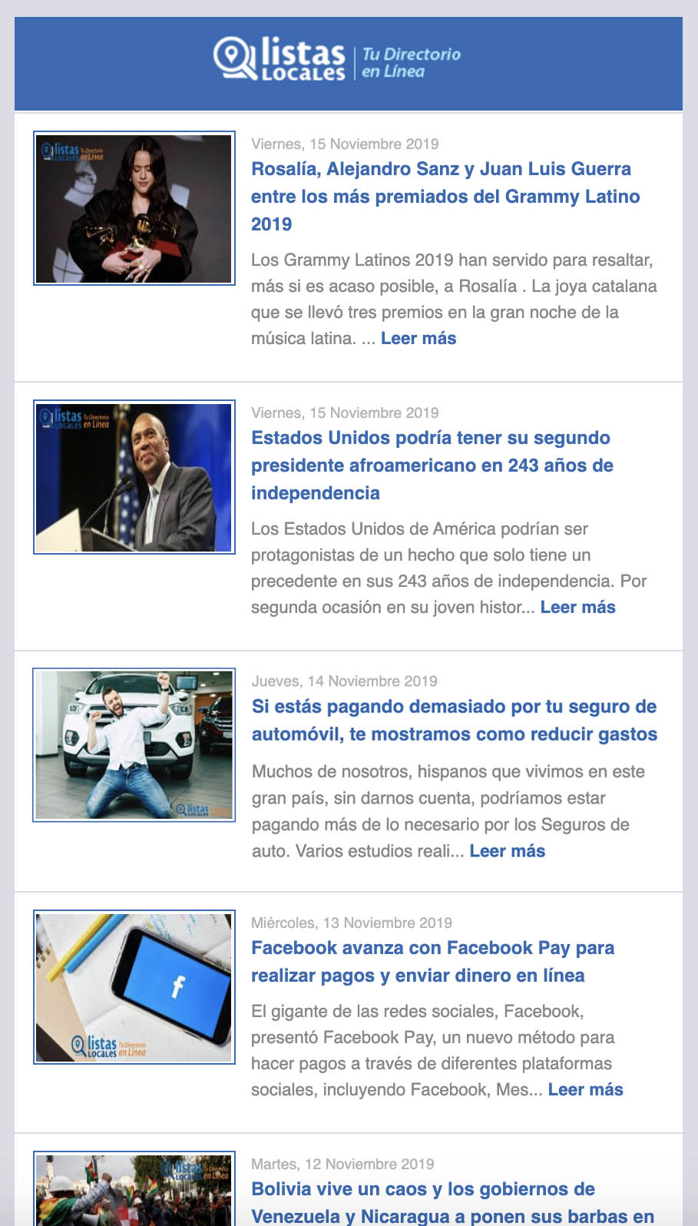
Newsletters
These newsletter are sent often depending on the week, client traffic and or activity with current events and it is published every day on social
networks. The writing team focuses on
creating engagement with the user to
Act with linking to specific categories.
The article does not necessarily have to be Insurance (These are examples),
but in some we can find a way to integrate some
paragraph related to various client vertical(s).
Example: An article of tips to paint your house. We introduce; that if you need better coverage for
your home and be in good hands, look for the best
insurance in your city.
Backlink to insurance category
Example: new’s related to auto insurance.
Ad
Blogs related to insurance. With backlinks to different
insurance categories. (Inside Listas Locales)
Call to action
Call to action
Backlink to insurance category

Slide 11
Gracias!
From the entire
Listas Locales Team
LSA Pub # 0840
Rates also available
In Localogy Rates &
Data.
Visit www.listaslocales.com

